Slide 1

Equity, Math, and the Opportunity Gap: What Does it Mean to Schools and Systems?
NC SIP Conference
March 28, 2017
Valerie Faulkner, Ph. D.
Teaching Assistant Professor
NC State University
Teacher Education & Learning Sciences
Notes:
Aristotle said…we are what we habitually do.
But what if what we think we are doing is not what we are doing at all? Then who are we.
I am a teaching professor in the Department of Teacher Ed and Learning Sciences in the Elementary Education program. So I am going to ask this question about Thinking and Doing as it relates to education and our ideas about how we Value our youngest students.
I am also going to ask us to consider an issue commonly known as the Achievement Gap in a way you may not have before.
The achievement gap is a name given to a phenomenon that is demonstrated by comparing the performance of students in different demographic groups. For instance, comparing students of different socioeconomic background or different ethnicity or race.
It looks like this:

Slide 2
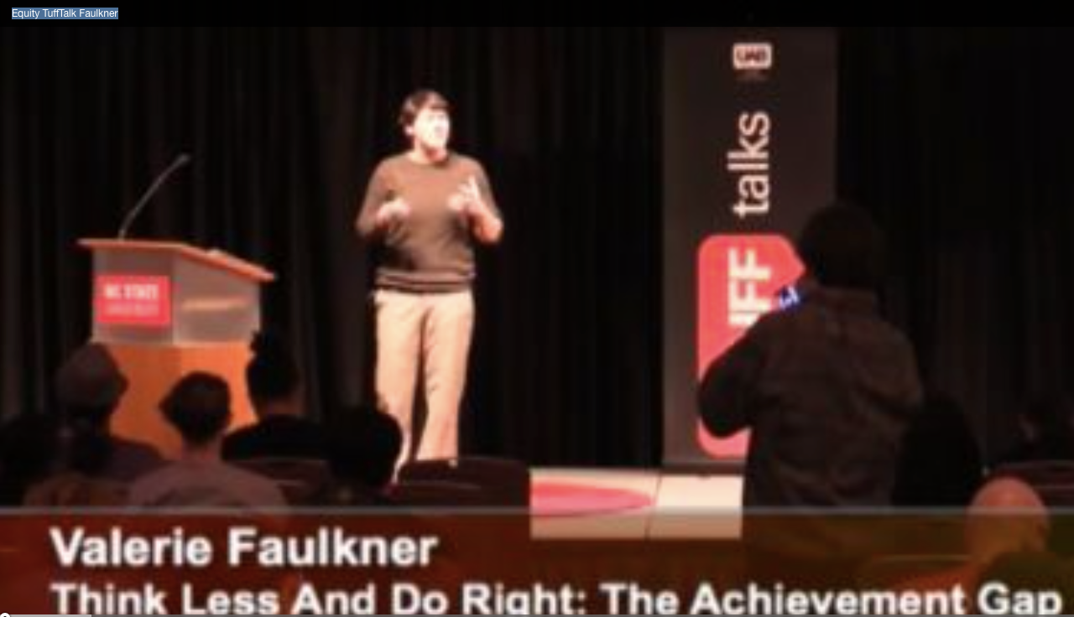
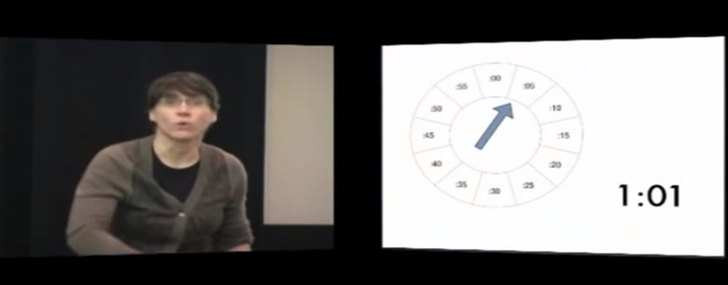
16 minute Talk on Equity
18 minute TEDx
Talk on Math
valeriefaulknermathclub.com

Slide 3
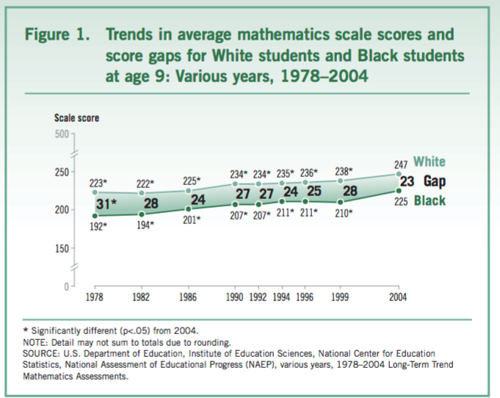

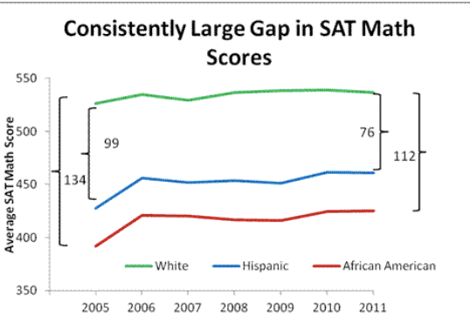

“Achievement Gap”
Scores
Academic Years
Scores
Provide with More Support
to make up for their
Academic Weakness
Academic Years
www.njea.org
Notes:
If we look at student performance on certain assessments over the academic years we see that there is this identifiable ‘gap’. Next, or so the story goes, we must put our resources into these students who are AT RISK and provide them with more support to make up for their Academic Weakness.
Okay, let’s look at this.

Slide 4

Large beats Small
Kids
Kids
Kids
Kids
Kids
Notes:
First I want you to think about something you already know: Large High schools beat Small high schools in sports almost every time.
Why? Are the kids more innately talented? No, there are just more of them.

Slide 5


Diversity beats Ability
Best
Weak
Best
Best
Weak
Best
Best
Best
Scott Page, 2007, The Difference: How the Power of Diversity Creates Better Groups, Firms, Schools, and Societies also see James Surowiecki, The Wisdom of Crowds, p. 30.
Notes:
Second - In his book The Difference, Scott Page describes how he has found that random groups of more Diverse problem solvers outperformed homogeneous groups of the Best problem solvers virtually every time. Or as he puts it he has found that Diversity Trumped Ability. You can also read more about the phenomenon of the power of Diversity in the book, The Wisdom of Crowds by James Surowiecki.
So keep these two ideas in mind: Large beats Small , and Diversity beats Ability.

Slide 6

Emergency Room
Doctor Protocol
Vital Signs
Physical Exam
Social History
Professional Judgment
?
Brendan Reilly in Gladwell, Blink
Notes:
Now let’s go to a hospital emergency room.
In a Chicago hospital short on funds, Brendan Reilly was
Tasked with improving the rate at which doctor’s predicted who needed to be admitted for an imminent heart attack and who needed to be sent home.
At the time he took over, the protocol was for doctors to gather the data they saw fit, including social histories and performing a physical exam, and then use their professional judgment to make the call.

Slide 7
Emergency Room
Goldman Formula
Protocol
4 Vital Signs Only
ECG
Systolic BP
Fluid in Lungs
Unstable Angina
?
Brendan Reilly in Gladwell, Blink
Notes:
Reilly suggested instead that the hospital use the Goldman formula which factored in only the patients ECG, systolic BP, presence of fluid in lungs, and the presence of unstable angina.
Eventually the hospital used the Goldman Formula for a period of time to compare the effectiveness of the two protocols

Slide 8
?
Goldman Formula
Doctors’ Professional Judgment
95% accuracy at predicting heart attacks
$ 70% better at sending people home who were not having a heart attack
75%-89% accuracy at predicting heart attacks
Notes:
The results were clear: The Formula did a better job than the Doctors and their professional judgment.
Why is that?
Consider the Assumptions Doctors are probably making that might interfere with their interpretation of the subject? They are likely factoring in things that aren’t actually that good at predicting an imminent heart attack: Body Weight? Gender? Family History?
But here is the apparent problem - THESE ASSUMPTIONS about patients and their overall health are likely interfering with the Doctors’ judgments because long term health issues are not exactly the same as the issue of an imminent heart attack.
But Doctors are not alone here. We all do this.
For instance consider what many of us have learned from Moneyball - Professional Baseball Scouts tend to

Slide 9
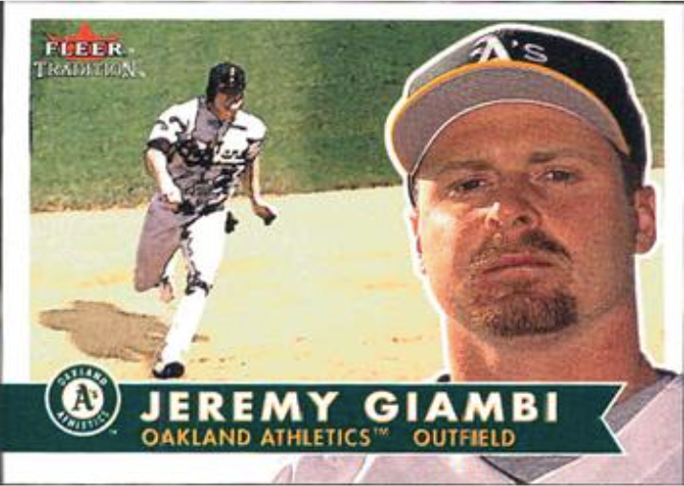
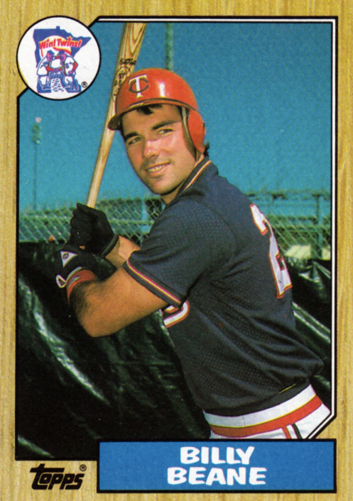
http://newdesultorybaseball.tumblr.com/post/33712438893
http://www.tradingcarddb.com
Under-Value Players who
don’t look the part
Over-Value Players who
“Look” the part
Notes:
Overvalue players that look the part and
UnderValue players who don’t look the part
It appears that Professional Scouts make assumptions about players based on factors such as high profile stats and reputation that are interfering with their ability to identify who is actually going to help them win games.

Slide 10
Point # 1
We are surprisingly bad at evaluating what other people can and will do even when we have a vested interest in getting it right
Our Assumptions appear to be a culprit
Notes:
And this brings us to point number 1.
We are surprisingly bad at evaluating what other people can do AND Our Assumptions appear to be a culprit
Click then Hockey

Slide 11
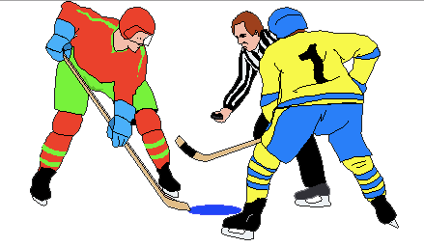
Disproportionately
Professional
Hockey Players
Born in January February March
http://www.clipartlord.com
Notes:
Next, let’s look at Hockey. It is now well-documented that players born in the early months of the year are more likely to play at elite levels of the sport.
That’s really strange isn’t it? (Wrinkle nose)
Is that really true? Why would it matter if you were born in January, February, or March?

Slide 12
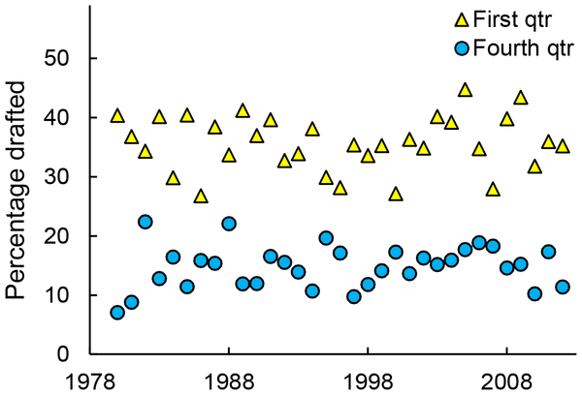



Figure 1. Percentage of NHL draftees born in the first or fourth quarter over time.
Born in January February March
Born in October November December
Deaner RO, Lowen A, Cobley S (2013)
Born at the Wrong Time: Selection Bias in the NHL Draft. PLoS ONE 8(2): e57753. doi:10.1371/journal.pone.0057753
http://127.0.0.1:8081/plosone/article?id=info:doi/10.1371/journal.pone.0057753
Notes:
Here Deaner, Lowen and Cobley have graphed this phenomenon using the percentages of players drafted from 78-08.
Yellow triangles represent players born in the first quarter of the year
and the blue circles represent players born in the last quarter of the year for each year of the draft.
Just to make sure this is clear let’s take a look at just one year: 1998. You can see here that in 1998 about 32% of the players drafted were born in the first quarter of the year and about 12% of the players drafted were born in the last quarter of the year.
Again - this doesn’t really make sense does it? Is there any reason to believe that people born in November are innately less capable hockey players. No - Of course not. So how does this happen.

Slide 13


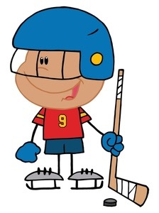
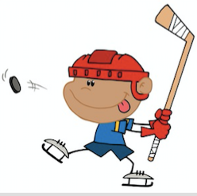
Elite
Cut
6y 11m
13% older than
6y 1m
Better or
just Older?
Rec
League
Rec
League
Elite Team
fanpop.com
clipart panda.com
Notes:
In hockey-playing communities very young kids play hockey and are assessed for their talent so that coaches can develop them through Elite Traveling teams.
But There are assumptions going on because of the seemingly innocuous Cut-Off date of January 1st that determines the age groups for these young players.
So, as I evaluate the players in my recreation league the oldest kids look like the most talented because they are the strongest and most developed. And so, Age becomes a Proxy for determining talent. Then the assumptions about the Needs of the Talented kids allow us to justify cutting the youngest players. The talent of the younger players is overlooked because we valued them differently and we then justified providing them with different, and likely inferior, experiences based on what we thought they could do.

Slide 14
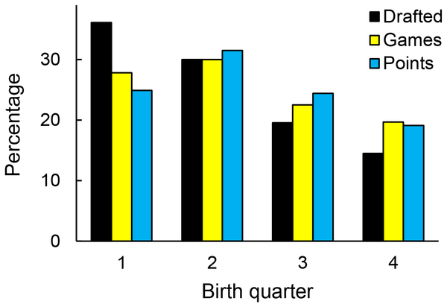
Figure 2. Percentage of draftees and productivity by relative age.
Deaner RO, Lowen A, Cobley S (2013) Born at the Wrong Time: Selection Bias in the NHL Draft. PLoS ONE 8(2): e57753. doi:10.1371/journal.pone.0057753
http://127.0.0.1:8081/plosone/article?id=info:doi/10.1371/journal.pone.0057753

Slide 15
Figure 2. Percentage of draftees and productivity by relative age.
Deaner RO, Lowen A, Cobley S (2013) Born at the Wrong Time: Selection Bias in the NHL Draft. PLoS ONE 8(2): e57753. doi:10.1371/journal.pone.0057753
http://127.0.0.1:8081/plosone/article?id=info:doi/10.1371/journal.pone.0057753

Slide 16
Point # 2
When we ‘cut’ people we don’t Gain:
We Lose
Resources.

Slide 17


This doesn’t
make sense!
Figure 1. Percentage of NHL draftees born in the first or fourth quarter over time.
Deaner RO, Lowen A, Cobley S (2013) Born at the Wrong Time: Selection Bias in the NHL Draft. PLoS ONE 8(2): e57753. doi:10.1371/journal.pone.0057753
http://127.0.0.1:8081/plosone/article?id=info:doi/10.1371/journal.pone.0057753
Does this make sense?
Notes:
When we heard the hockey statistic we immediately wrinkled our noses and thought - Well that doesn’t make sense!
But these ‘achievement gap graphics represents an almost identical phenomenon to the hockey graphic:

Slide 18
Figure 1. Percentage of NHL draftees born in the first or fourth quarter over time.
Opportunity Gap
Deaner RO, Lowen A, Cobley S (2013) Born at the Wrong Time: Selection Bias in the NHL Draft. PLoS ONE 8(2): e57753. doi:10.1371/journal.pone.0057753
http://127.0.0.1:8081/plosone/article?id=info:doi/10.1371/journal.pone.0057753
Opportunity Gap
Notes:
The gap in hockey is Obviously an Opportunity Gap. And so are the gaps in Education.

Slide 19
Schmidt & Burroughs, 2015. Puzzling out PISA,
American Educator (39) 1, p. 25
It’s not just that lower-income students are less well prepared when they enter school; the weakness of their math coursework actually keeps them from catching up.
Notes:
In other words, just like the young hockey players, any small difference in development upon entry into school is exacerbated. once students get into school students are evaluated and put into different perceived ability groups that create differences in opportunity and then the weakness of their math course work actually keeps them from catching up.
But please take note:
We tend to investigate these issues at the SCHOOL Level - but remember it is an entire community of individuals and parents that put pressure on schools to place kids into Elite type classes and to attain an elevated status. And every time we elevate some group of 6 or 7 or 8 year olds to a higher status we are essentially ‘cutting’ other kids because of our assumptions about what these kids can Think and Do and our assumptions that less diverse, elite groups are somehow desirable. We Think we are Doing the right thing by providing some kids with different opportunities. But I say, let’s Think less and Do the Right thing. What do I mean?
Well, let me tell you about my dad. My father, who died a few years ago, was a teacher and a football coach and he addressed this problem back in the 1950s because he was motivated to be a great football coach who produced great teams and great players. After he died my brother and I located some surprisingly recent articles that discussed his achievements.

Slide 20
Emergency Room
Doctor Protocol
Vital Signs
Physical Exam
Social History
Professional Judgment
?
Brendan Reilly in Gladwell, Blink
Notes:
Now let’s go to a hospital emergency room.
In a Chicago hospital short on funds, Brendan Reilly was
Tasked with improving the rate at which doctor’s predicted who needed to be admitted for an imminent heart attack and who needed to be sent home.
At the time he took over, the protocol was for doctors to gather the data they saw fit, including social histories and performing a physical exam, and then use their professional judgment to make the call.

Slide 21
Difference between
Teachers and Doctors?
We don’t actually NEED to make the call —
We don’t NEED
to put students in different ‘rooms’

Slide 22
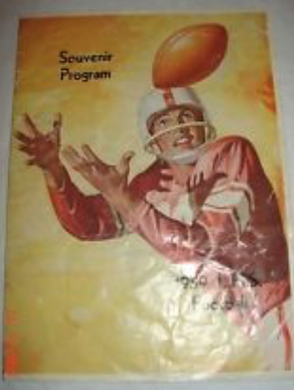
A new era was launched by
Tom Faulkner in 1957, although his troops struggled the first three years before putting together a pair of 6-4 seasons.
The Morning Call
December, 16, 1993
Notes:
He set up camp in Lehighton, PA in 1957 and turned the Lehighton football program around.
How did he do that? For starters, he said he never cut a player who came out to play football. And he went even farther than that - He changed the culture of the town.

Slide 23

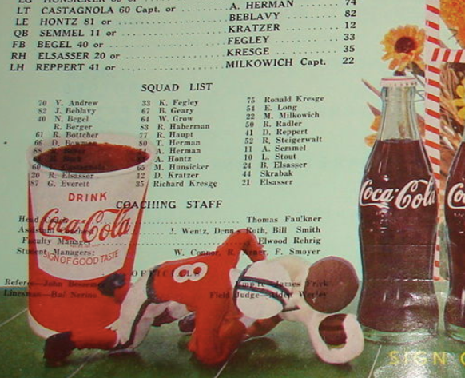

Slide 24
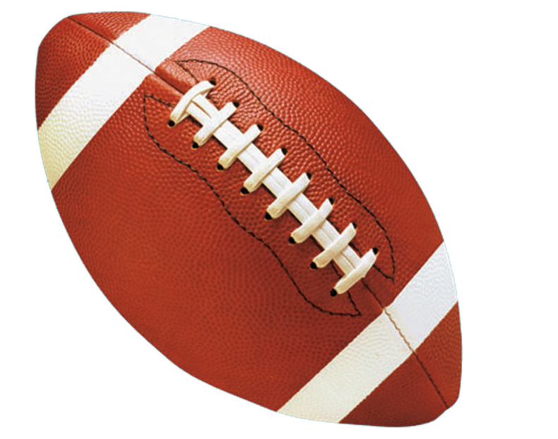
Lehighton
Other Towns
“Best”
Cut
Team
Team
“Best”
Cut
Cut
Cut
Team
Team
Cut
Cut
“Best”
Cut
Cut
Cut
Notes:
Just as with the Hockey Leagues, little league football programs functioned with the idea that elevating the Elite players, and putting more money and resources into them via their traveling team play, would be the best way to develop talent within the football community.
My Dad said - No: we are not going to do that. We are not going to put our resources into one elite team - we are going to have 4 teams within Lehighton and we are going to play each other. That’s it.
Not only that - he instituted regulations to ensure all kids played - no matter their perceived talent level or the assumptions made about them by adults.

Slide 25
The (Lehighton Athletic Booster)Club has a mandatory playing-time rule that benefits each player. The rules call for every pee-wee (2nd-5th) to play
at least one quarter of each game, and every knee-hi (6th-7th) player must play
at least half of the game.
The Morning Call September 7, 2000
Notes:
These mandates he created are still in place: All kids must be put out on the field, no matter what the Adults perceive their talent level to be.

Slide 26
"Here, everyone gets to play," (club president Lamont) Rodgers, said. "That way no one feels discouraged, and they will keep interest in the sport as they get older.”
The Morning Call September 7, 2000
Notes:
Rather than taking pride in having the best Elite team of young kids in the region, their is some evidence that the culture here is to take pride in this idea that all young kids within Lehighton are given a chance to play football.

Slide 27
Lehighton
Other Towns
All
Kids
“Best”
Cut
Play
Football
Cut
Cut
Notes:
What’s really great about this system - is that it creates a larger Pool size AND maintains Diversity. So, while we can’t predict who the best players might end up to be when they are older, we can predict that towns that do this will have stronger programs in the long run than those that cut their pool into pieces and eliminate their own diversity of skills.
My dad used to say “I don’t want someone to make the decision, at the age of 6 or 7, of who my high school Quarterback is going to be. I want there to be many kids who get to play quarterback, and all of the different positions, when they are small, so that by the time they get to high school there are lots and lots of different players who have had the practice and can play football. This makes us stronger at the High School Level than if only some kids can play football and others have been cut”

Slide 28
Healthy Society
Current System
All
Young
Kids
“Gifted and Talented”
“Low”
Learn
Together
“Average”
“Average”
Notes:
Our current society is organized in a way that limits our pool and cuts down on our diversity of skills, talents, and perspectives. By the age of 7 we have already decided which of our students are ‘gifted’ and which are not. We have already separated them into different groups and classrooms for most, if not all, of their day. We Do this because we Think we are doing the right thing. it makes sense. But does it?

Slide 29
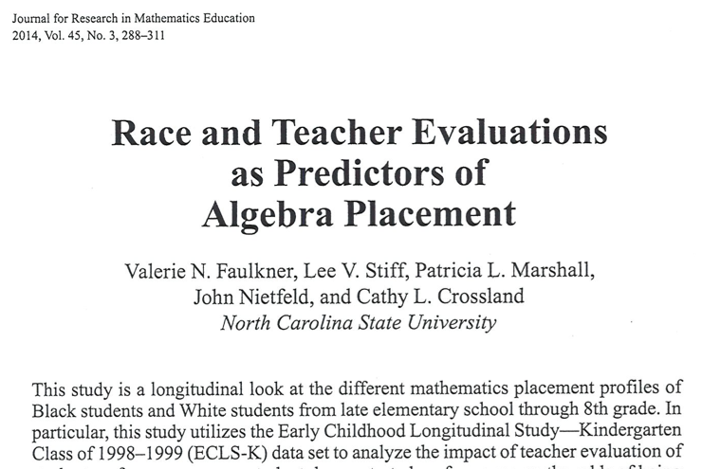

Slide 30
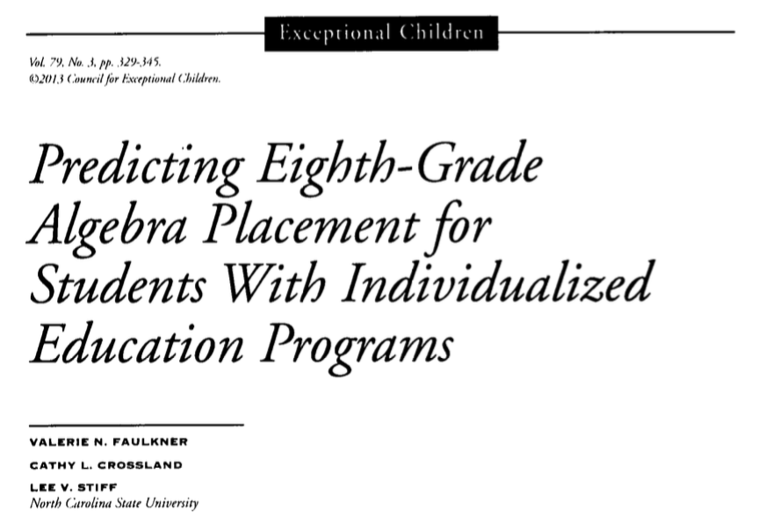

Slide 31
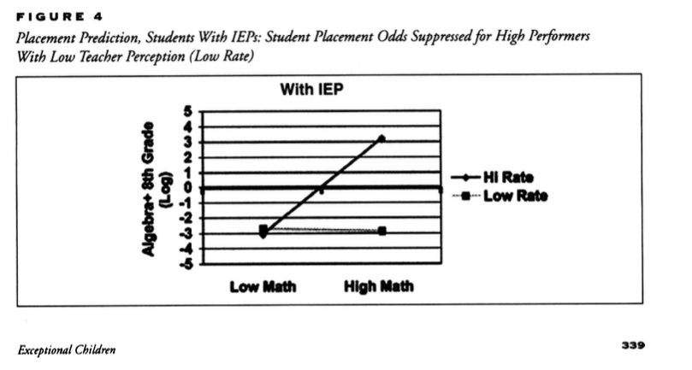

Slide 32
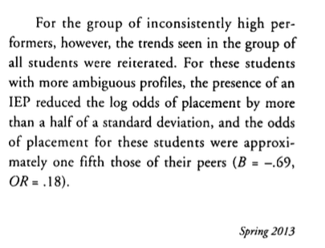

Slide 33
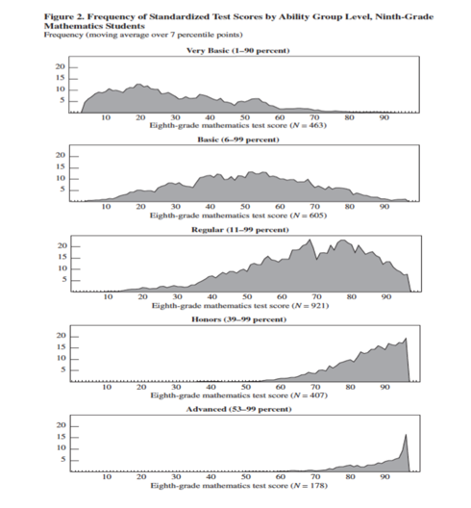
Hallinan, 2003

Slide 34
Hallinan, 2003

Slide 35
Hallinan, 2003

Slide 36

Growth Mindset
We can’t have it both ways…

Slide 37
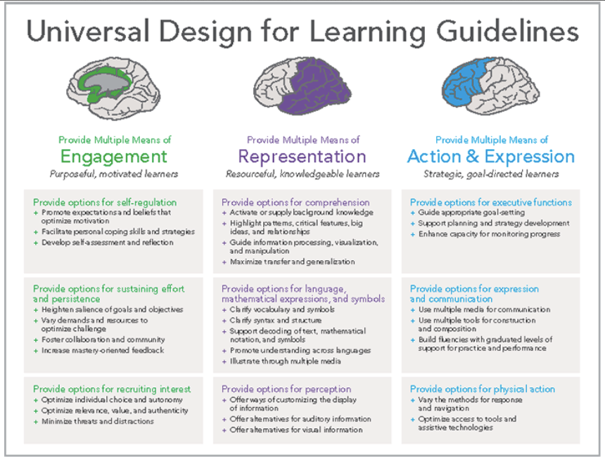

Slide 38
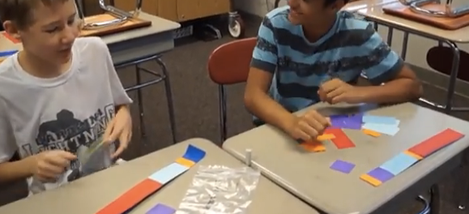
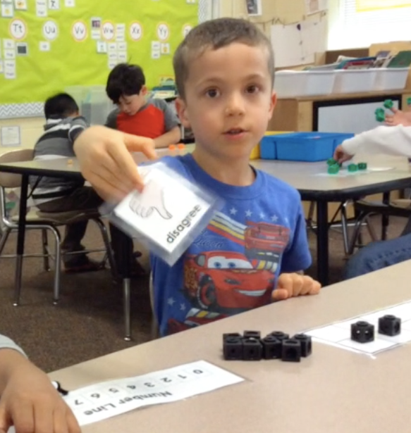
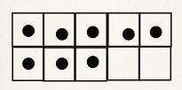
Verbs versus Nouns
What Skills and Concepts
do kids have?
What Skills and Concepts
do they need to work on?

Slide 39
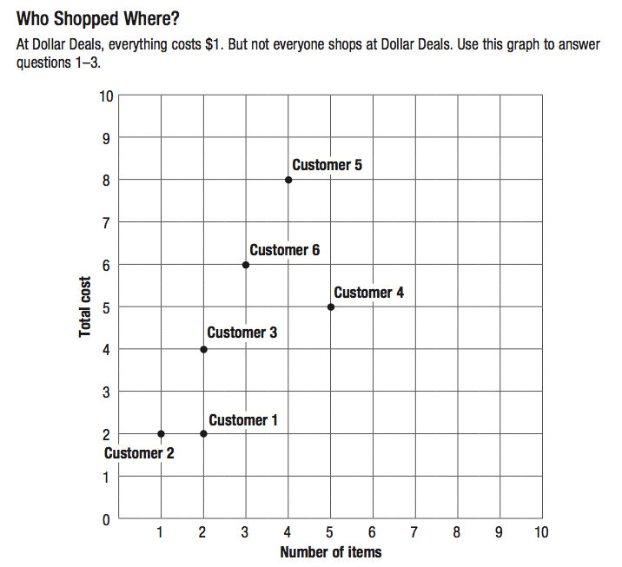
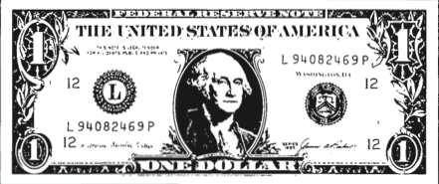
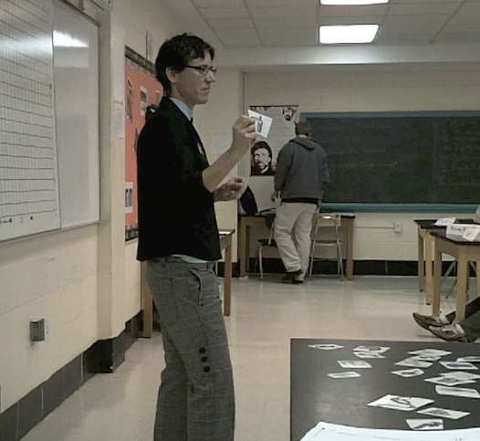


Slide 40

“…the strength of the Pack is the Wolf,
and the
strength of the
Wolf is the Pack.”
-Rudyard Kipling
Notes:
…the strength of the Pack is the Wolf, and the strength of the Wolf is the Pack.” -Rudyard Kipling
Thank you.

