Slide 1

Watch the C10 Background Video
Before Subitizing at C10 Level
Orange County, NC

Slide 2
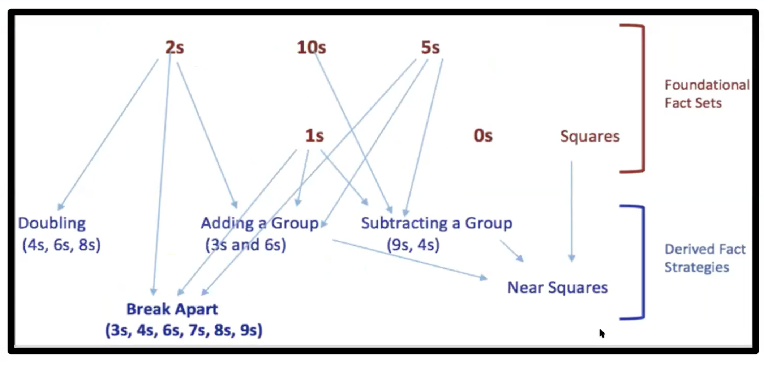
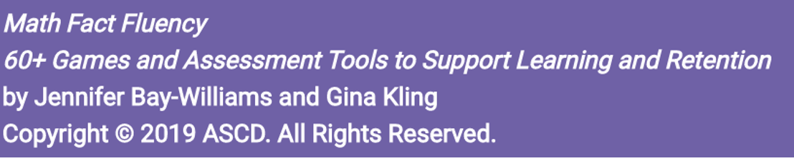

Slide 3
The factors are 3 and 2
The number of groups and
the amount in each group
The product is the total amount 6

Slide 4
How many black dots do you see?
How did you get that?

Slide 6
How many groups do you see?
Do you see 3 groups of 2 dots?
Or 2 groups of 3 dots?

Slide 8
How many black dots do you see?
How did you get that?

Slide 10
How many groups do you see?
Do you see 2 groups of 3 dots?
Or 3 groups of 2 dots?

Slide 12
In the following slides we want to know the factors and the product

Slide 15
Factors: 1 and 2
1 group of 2 dots = 2 total dots
Product: 2
1 x 2 = 2

Slide 19
Factors: 3 and 2
3 groups of 2 dots = 6 total dots
Product: 6
3 x 2 = 6

Slide 22


Use your hands and fingers to describe 2 x 5

Slide 23
“I thought of it as
Two of each type of finger
2,4,6,8,10”

Slide 24
“I counted by twos
on one hand
2,4,6,8,10”

Slide 25
“I know that five twos equals two fives
So I thought double 5 is 10”

Slide 33
What did you see?
Use your fingers and hands
to explain

Slide 34
a Hand of 2s + a Hand of 2s

Slide 35
5 groups of 2 + 5 groups of 2

Slide 36
2 tens!

