Slide 1
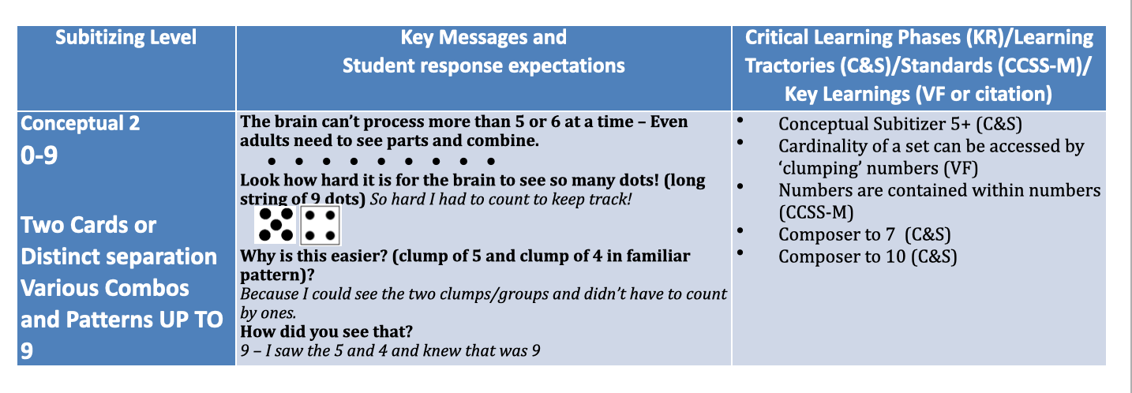
Live Action -
Subitizing C2 Set 1
Conceptual Subitizing 0-9
Faulkner 4/29/20. Slides based on Faulkner, Ainslie 2017

