Slide 1
Subitizing Mixed Practice
Faulkner

Slide 33
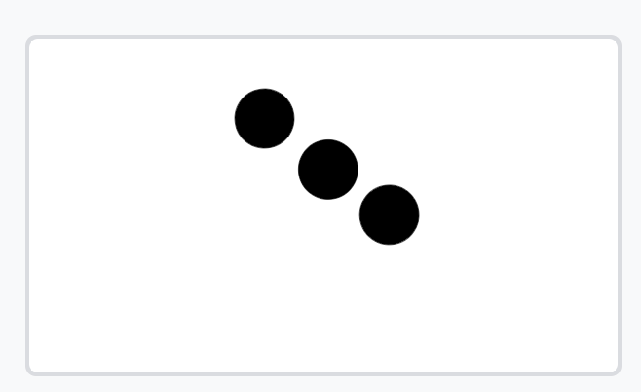


Slide 35


Slide 44
Notes:
Subitizing starts out with perceptual wiring and firing.

Slide 45
Notes:
WHAT!! That’s a big one!

Slide 65
Notes:
Five is one more than four

Slide 67
Notes:
How much is this? What happened? Why isn’t it a set of five any more?
What could we do to get our set of 5 circles again? What do we need?

Slide 69
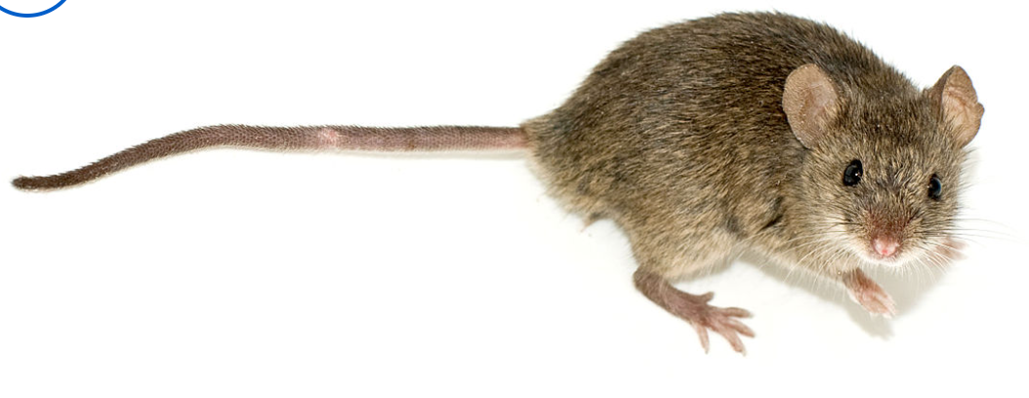
Notes:
What’s that?! That’s still 4 circles and a mouse!!! So do we have 4 circles? Yes, but No, we have 4 circles and a mouse!!

Slide 71
Notes:
How much is this? What happened? Why isn’t it a set of five any more?
What could we do to get our set of 5 circles again? What do we need?

Slide 73
Notes:
What about this? Do we have 5 circles?

Slide 75
Notes:
How much is this? What happened? Why isn’t it a set of five any more?
What could we do to get our set of 5 circles again? What do we need?

Slide 77
Notes:
So five is one more than four… Keep an eye out for that.

Slide 87

Notes:
Four tall fingers and a thumb finger!

Slide 116
Notes:
Discuss that you have seen 5 before in one set.
Now we are going to see 5 broken down into two sets, just like we have for one thru four.

Slide 117
Notes:
Subitizing starts out with perceptual wiring and firing. But it is at all times more than that as well. Develop classroom community, language, and precision in thinking.
For instance, INTRODUCING FIVE. I know that subitizing past 4 is more strenuous than subitizing 4 and under. So when I introduce 5, I continue working on other important topics. In this way, we have time to develop a sense of fiveness because we are playing with it while also discussing other precise, critical, daily habit level messages and understanding.

Slide 118
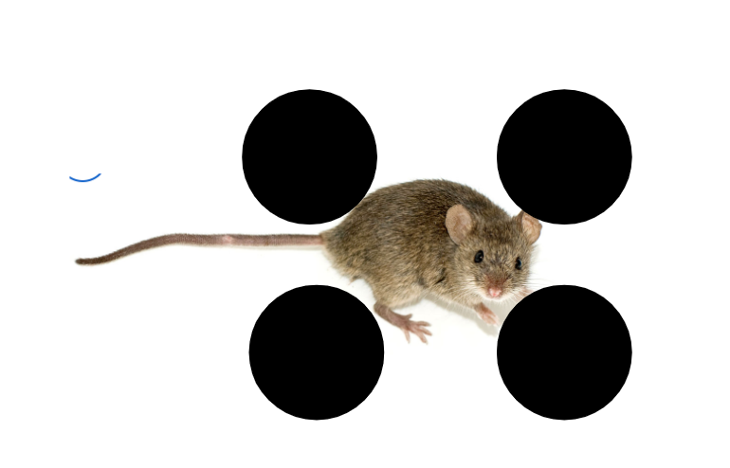
Notes:
What’s that?! That’s still 4 circles and a mouse!!! So do we have 4 circles? No, we have 4 circles and a mouse!!

Slide 119
Notes:
Subitizing starts out with perceptual wiring and firing. But it is at all times more than that as well. Develop classroom community, language, and precision in thinking.
For instance, INTRODUCING FIVE. I know that subitizing past 4 is more strenuous than subitizing 4 and under. So when I introduce 5, I continue working on other important topics. In this way, we have time to develop a sense of fiveness because we are playing with it while also discussing other precise, critical, daily habit level messages and understanding.

Slide 120
Notes:
How much is this? What happened? Why isn’t it a set of five any more?
What could we do to get our set of 5 circles again? What do we need?

Slide 121
Notes:
Subitizing starts out with perceptual wiring and firing. But it is at all times more than that as well. Develop classroom community, language, and precision in thinking.
For instance, INTRODUCING FIVE. I know that subitizing past 4 is more strenuous than subitizing 4 and under. So when I introduce 5, I continue working on other important topics. In this way, we have time to develop a sense of fiveness because we are playing with it while also discussing other precise, critical, daily habit level messages and understanding.

Slide 122
Notes:
What about this? Do we have 5 circles?

Slide 123
Notes:
Subitizing starts out with perceptual wiring and firing. But it is at all times more than that as well. Develop classroom community, language, and precision in thinking.
For instance, INTRODUCING FIVE. I know that subitizing past 4 is more strenuous than subitizing 4 and under. So when I introduce 5, I continue working on other important topics. In this way, we have time to develop a sense of fiveness because we are playing with it while also discussing other precise, critical, daily habit level messages and understanding.

Slide 124
Notes:
How much is this? What happened? Why isn’t it a set of five any more?
What could we do to get our set of 5 circles again? What do we need?

Slide 125
Notes:
Subitizing starts out with perceptual wiring and firing. But it is at all times more than that as well. Develop classroom community, language, and precision in thinking.
For instance, INTRODUCING FIVE. I know that subitizing past 4 is more strenuous than subitizing 4 and under. So when I introduce 5, I continue working on other important topics. In this way, we have time to develop a sense of fiveness because we are playing with it while also discussing other precise, critical, daily habit level messages and understanding.

Slide 126
Notes:
So five is one more than four… Keep an eye out for that.

Slide 144
Notes:
What about this? Do we have 5 circles?

Slide 198
Notes:
Five is one more than four

Slide 200
Notes:
How much is this? What happened? Why isn’t it a set of five any more?
What could we do to get our set of 5 circles again? What do we need?

Slide 202
Notes:
How much is this? What happened? Why isn’t it a set of five any more?
What could we do to get our set of 5 circles again? What do we need?

Slide 204
Notes:
What about this? Do we have 5 circles?

Slide 206
Notes:
How much is this? What happened? Why isn’t it a set of five any more?
What could we do to get our set of 5 circles again? What do we need?

Slide 208
Notes:
So five is one more than four… Keep an eye out for that.

Slide 218
Notes:
Bring Back Expanding set of 4 just once.

Slide 242
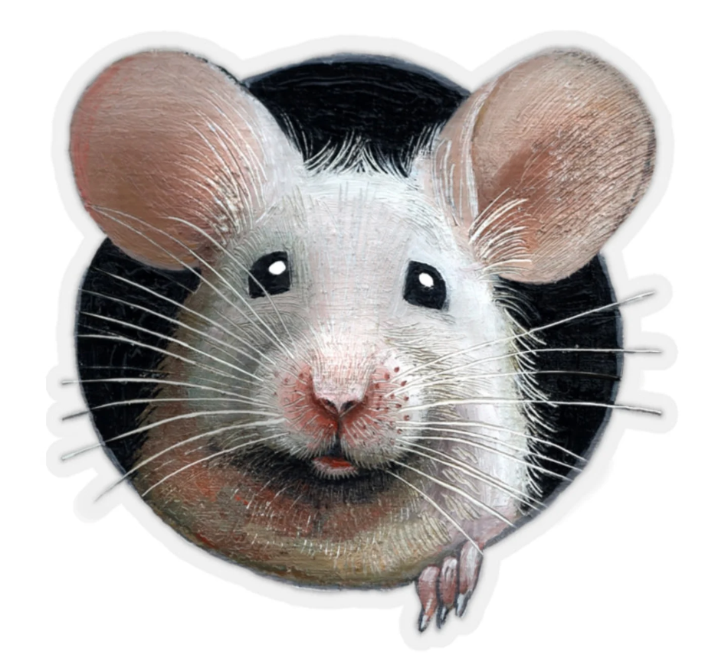

Slide 260
Notes:
One big circle and one little circle.
Can we say this is a set with ‘two circles?” Yes, we still can…

Slide 262
Notes:
One big circle and one little circle.
Can we say this is a set with ‘two circles?” Yes, we still can…

Slide 290
Are you ready for sets that add to FIVE?
5
Notes:
Oh look our mouse has a message for us!
They won’t all be combinations to 5. Be careful. Tell me the total amount. But look into your brain and make sure you notice what you see.

Slide 291
Notes:
Five! I see a 2 and a 3. 2 and 3 Make five.

Slide 357
Notes:
Three Fingers and two fingers. Still Five Fingers!!

Slide 367
Mixed Practice - Pay attention to Units

Slide 404
Who has more?/Who is winning?
How many more?/By how many?
Up to here we are even!

Slide 406
Who has less?
How many less?

Slide 408
Which has more, blue or orange?
How many more does it have?

Slide 410
Are you ready for sets that add to SIX AND SEVEN?
6 and 7
Notes:
Oh look our mouse has a message for us!
They won’t all be combinations to 5. Be careful. Tell me the total amount. But look into your brain and make sure you notice what you see.

Slide 411
Practice with 6 and 7. Then Mix these in.
5 or 6 - How do you know?
5 or 7 - How do you know?

Slide 478
Notes:
0 + 0. If students say 5 + 5 press for unit. This could be seen as 5 squares plus 5 squares.

Slide 480
Notes:
0 + 0. If students say 5 + 5 press for unit. This could be seen as 5 squares plus 5 squares.

Slide 497
WHAT IS DIFFERENTIATION?
NOT REALLY A STUDENT-CENTERED QUESTION:
NOT DIFFERENT FOR EACH STUDENT
NO DANGER OF HOLDING ANYONE BACK
IT IS ABOUT MOVING THROUGH THE LEVELS WITH THE WHOLE CLASS.
GOOD INSTRUCTION HAS PURPOSE.
GOOD INSTRUCTION IS ABOUT TIME ON TASK THAT HAS BRAINS ENGAGED WITH THE MATH
Task Based Question. What is differentiation? Same lesson to all students.
ASKING A FEW QUESTIONS THAT PUSH THE LEVEL.
BUT NOT SO MANY AS TO LOSE THE MAIN POINT OF THE LEVEL.
The main point of the level:
I CAN BREAK APART TO MAKE TEN TO MAKE PROBLEMS SIMPLER.
HMMM…I AM AN ACTIVE PART OF THE MATHEMATICS…
THIS MESSAGE IS LEARNED WITH SMALLER SECOND ADDENDS.
STAY WITH SMALLER SECOND ADDENDS AS LONG AS NEEDED TO ENSURE
ALL STUDENTS HAVE PLENTY OF TIME ON TASK FIRING THOSE BAMT SYNAPSES WITH MEANING.
When we emphasize a key and connected mathematics concept,
it benefits all children to spend more time on this task.

Slide 504
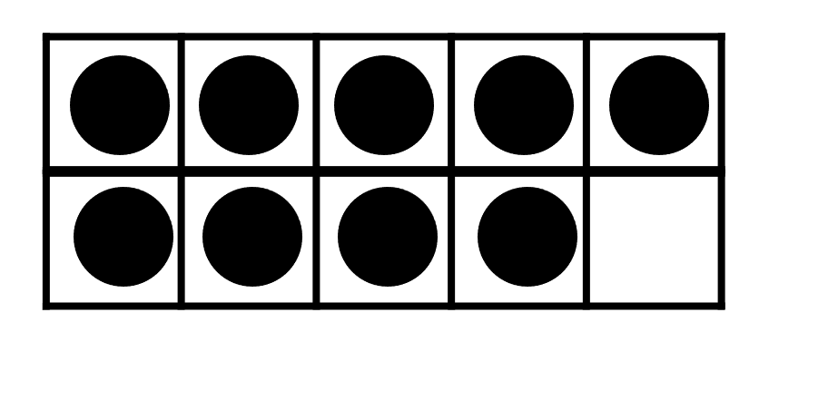

Slide 511
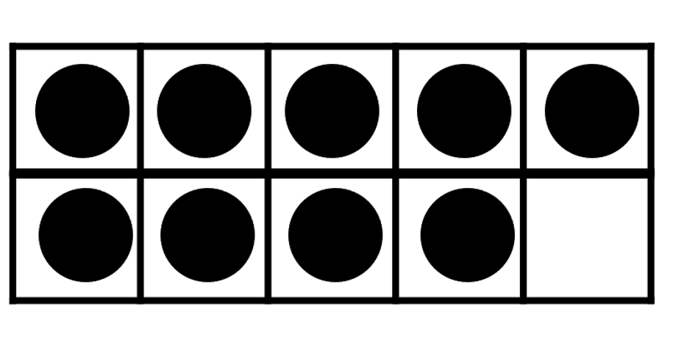

Slide 520
What is this value?

Slide 521
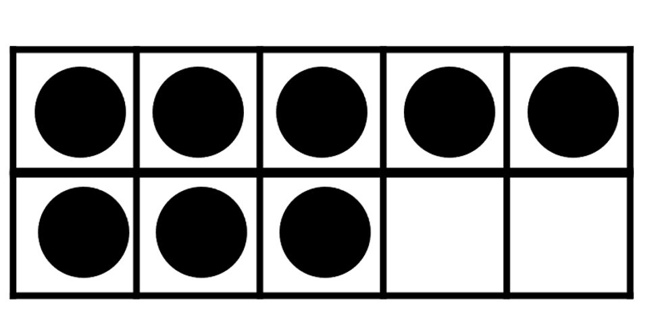
How many more do we need to make 10?

Slide 522
